Slide 1
Lifecycle Models
What software lifecycle models define
The economics of the project
Project risk management
The nature and scope of the project (size, timing, risks)
Product maintainability
Project architecture
Error detection/removal rates
Product completeness degree

Slide 2
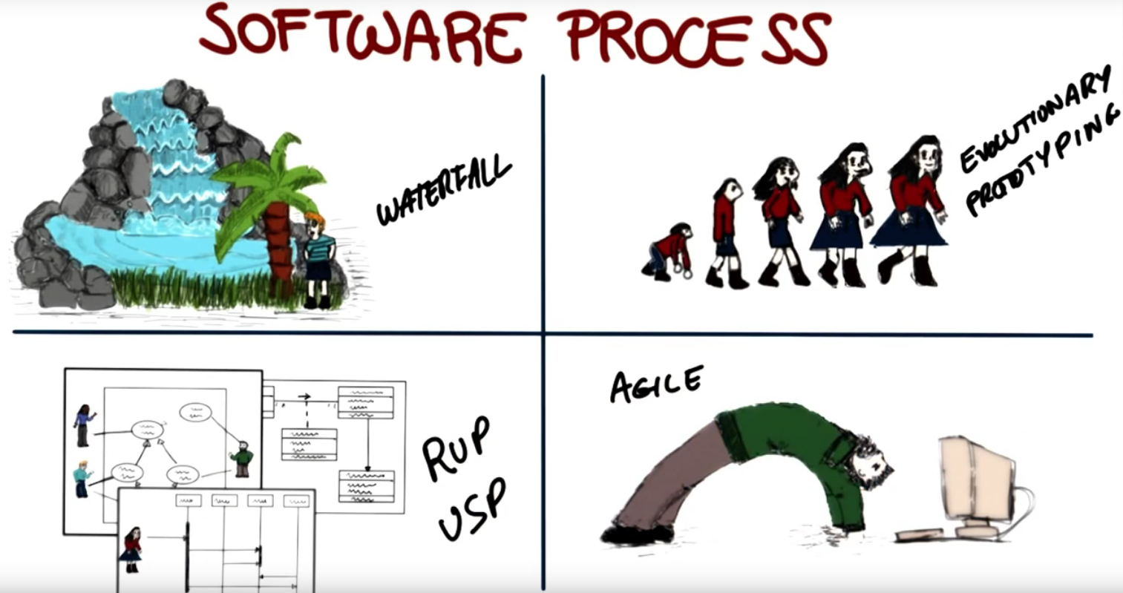
https://classroom.udacity.com/courses/ud805

Slide 3
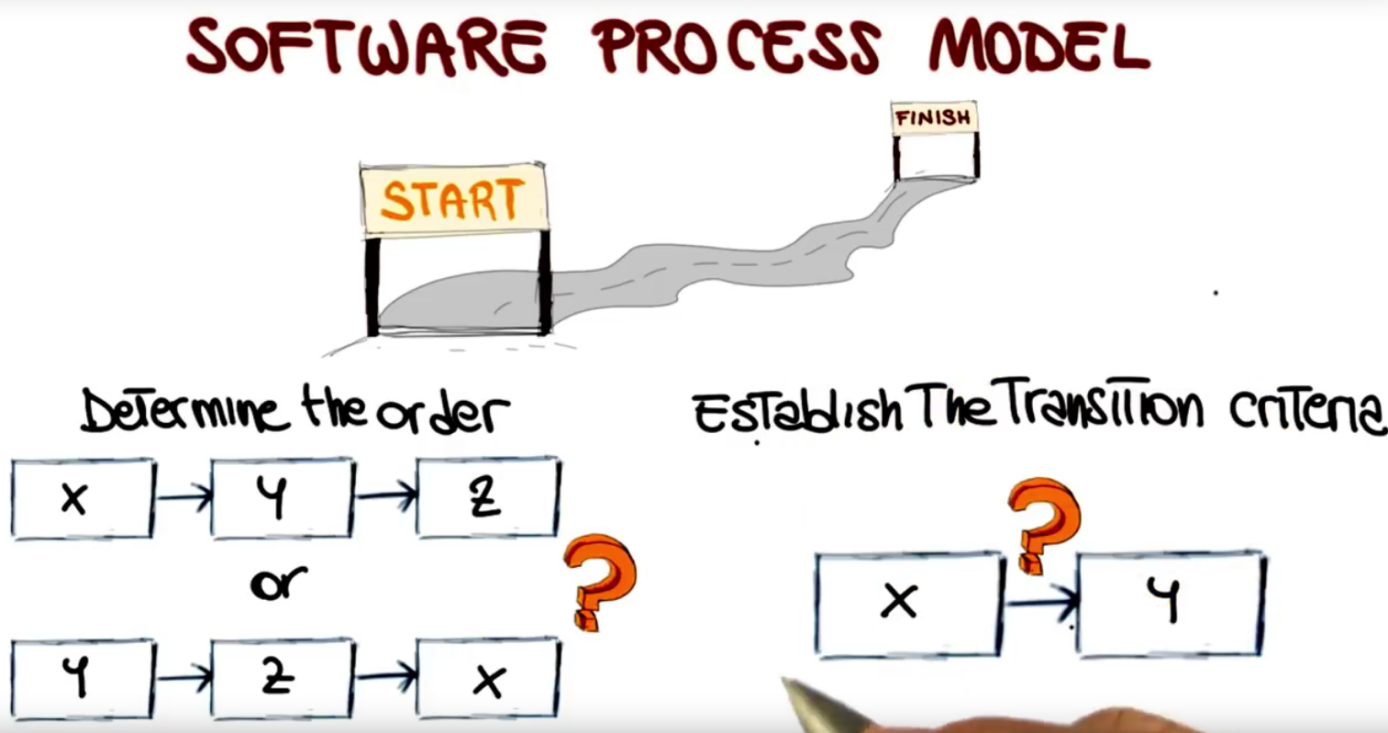
https://classroom.udacity.com/courses/ud805

Slide 4
Lifecycle Models
Lifecycle models
Agile models:
  Build-and-Fix model
  Incremental model
  Spiral model
  Rapid prototyping model
  Stabilization and synchronization model
Waterfall model
Object-oriented model
https://courses.edx.org/courses/course-v1:MEPhIx+MEPHI001x+2T2016

Slide 5
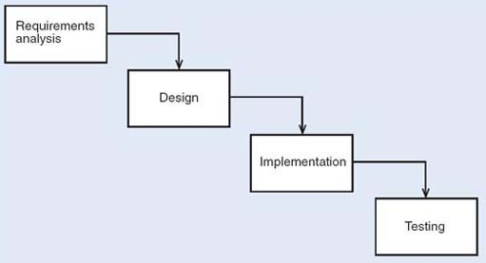
Waterfall Model

Slide 6
Waterfall Model features
Sequential change of all lifecycle phases
Software Quality Assurance (SQA)group verifies/tests results after phase (sometimes client side participates)
Feedback with earlier lifecycle phases
Benefit
Cost reduction for software correction (due to feedback)
Drawbacks
Requires technically «literate» client to create satisfactory specifications
Under high risks, should be combined with rapid prototyping

Slide 7
Waterfall Model
Clear project discipline
Document-driven model
The software may not meet the customer's requirements
Changes become complicated: terminated phases get «frozen»
Does not include iterations and evolution

Slide 8
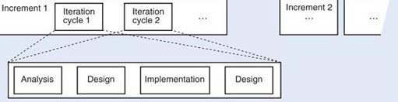
Incremental Model

Slide 9
Incremental Model
Benefits
The maximal earliest return on investments
It facilitates the maintainability
Disadvantages
It requires an open architecture
It can generate into Build-and-Fix

Slide 10
Incremential Model
Product decomposition to sequential releases (each development cycle gives an operational product)
Operational product at every development step
Flexible introduction of the new functionality at the client's site
Easy maintenance due to «straightforward expanding» of the major product modules

Slide 11
Rapid prototyping Model
Jim Highsmith offered three life cycle phases:
Speculation
Collaboration
Learning
Features
Rapid prototype has limited functionality and reliability/performance
Client has not technical knowledge to discuss requirements
Requirement analysis and specifications are generally possible before coding and testing

Slide 12
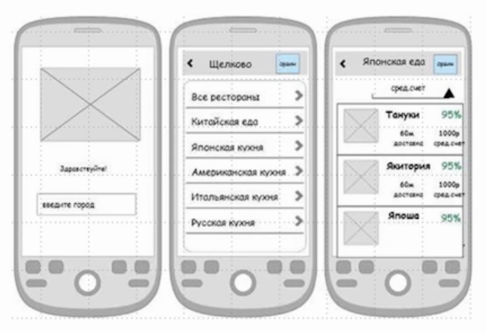
Rapid prototyping Model

Slide 13
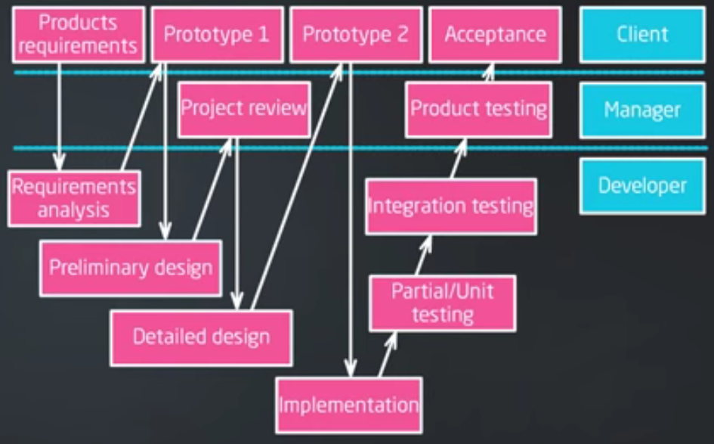
Rapid prototyping Model

Slide 14
Rapid prototyping Model
Rapid prototyping should be used in conduction with some other models
Benefit
Rapid prototyping ensures compliance with customer requirements
Drawback
User confusion of prototype and finished system

Slide 15
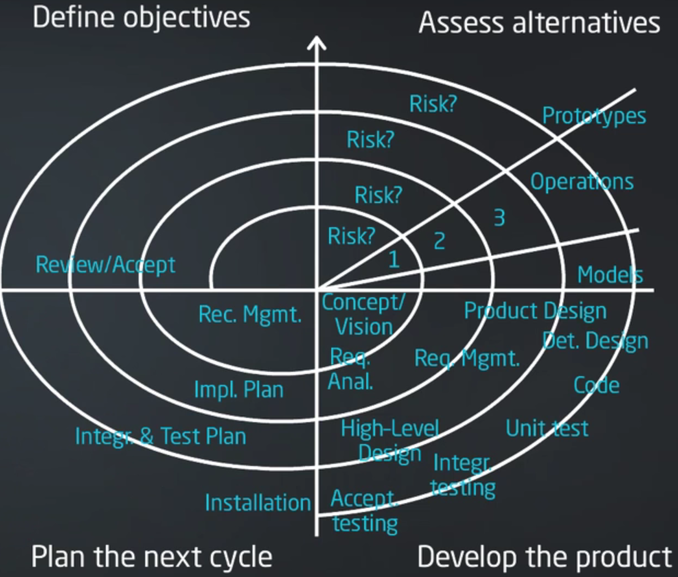
Spiral Model

Slide 16
Spiral Model
Features
Rapid prototyping advantages application to the entire lifecycle
Based on waterfall model and risk analysis
Risk analyzed at the start of each phase (detection and mitigating of the most serious project risks)
Project terminated if risks cannot be eliminated
Several prototyping steps and unlimited iterations number allowed

Slide 17
Object-Oriented Model
Features
Intensive interaction between lifecycle phases
Iterative lifecycle phases change
Phases interlap
Object Oriented Design (OOD) usually include Object Oriented Analysis (OOA) phases
Backtrack to earlier phases is possible

Slide 18
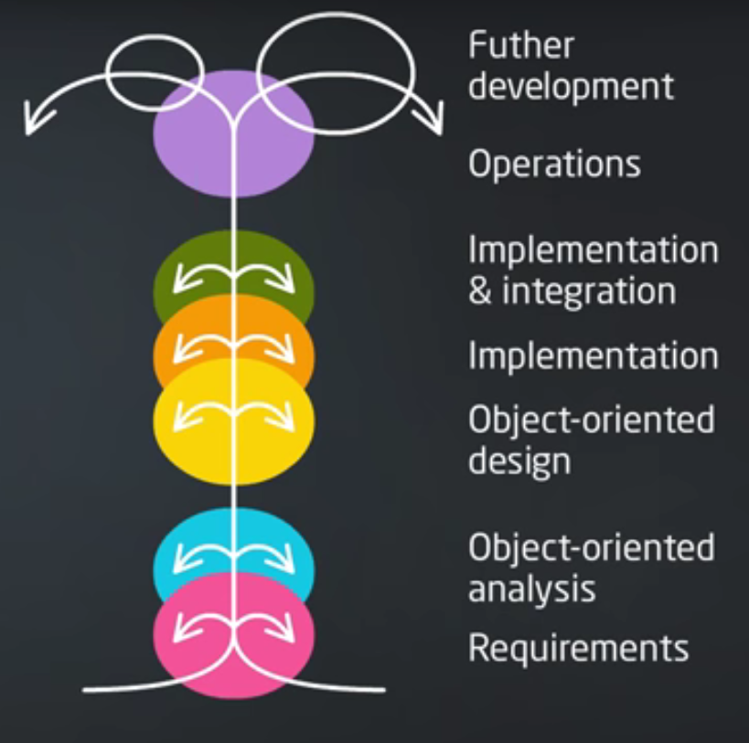
Object-Oriented Model

Slide 19
Object-Oriented Model
Benefit
It provides interaction and parallelism between the phases
Disadvantage
It can degenerate into CABTAB (Code a bit, test a bit) Build-and-Fix

Slide 20
Similarities of software lifecycle models
Include all stages of the software lifecycle (except Build-and-Fix)
It involves several iterations of project development
Software lifecycle stage is clearly distinguishable (except OO)
Related to the design methodology
Require a high organizational maturity and project development team discipline (can degenerate into CABTAB)

Slide 21
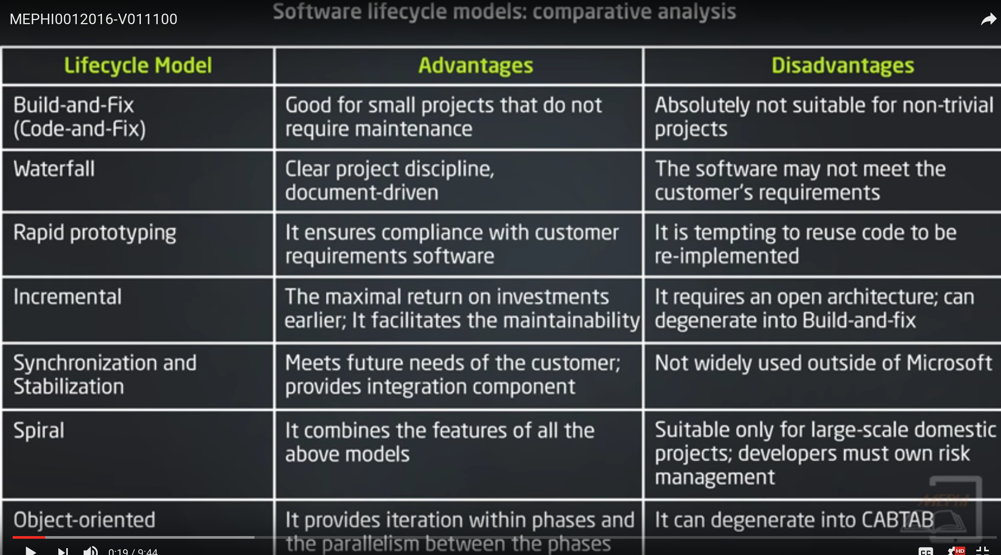

Slide 22
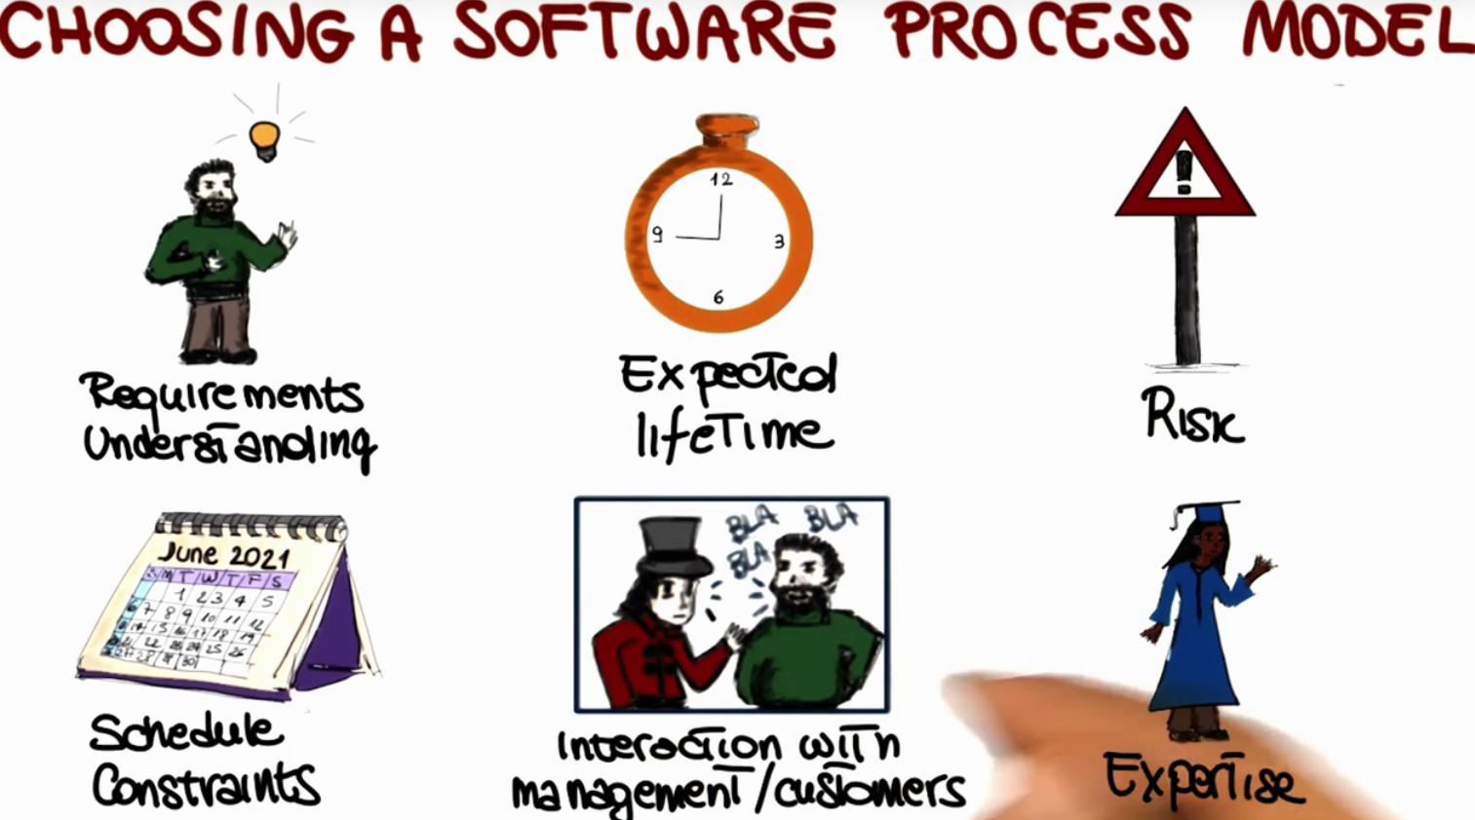

Slide 23
Which Development model to use?
Do you understand project area definitely?
Yes
No
Waterfall-based
Incremental-based
More than 100 specialists
Project/Team size?
5-8 specialist in 1 project/team
Yes
Project about expensive production?
No

Slide 24
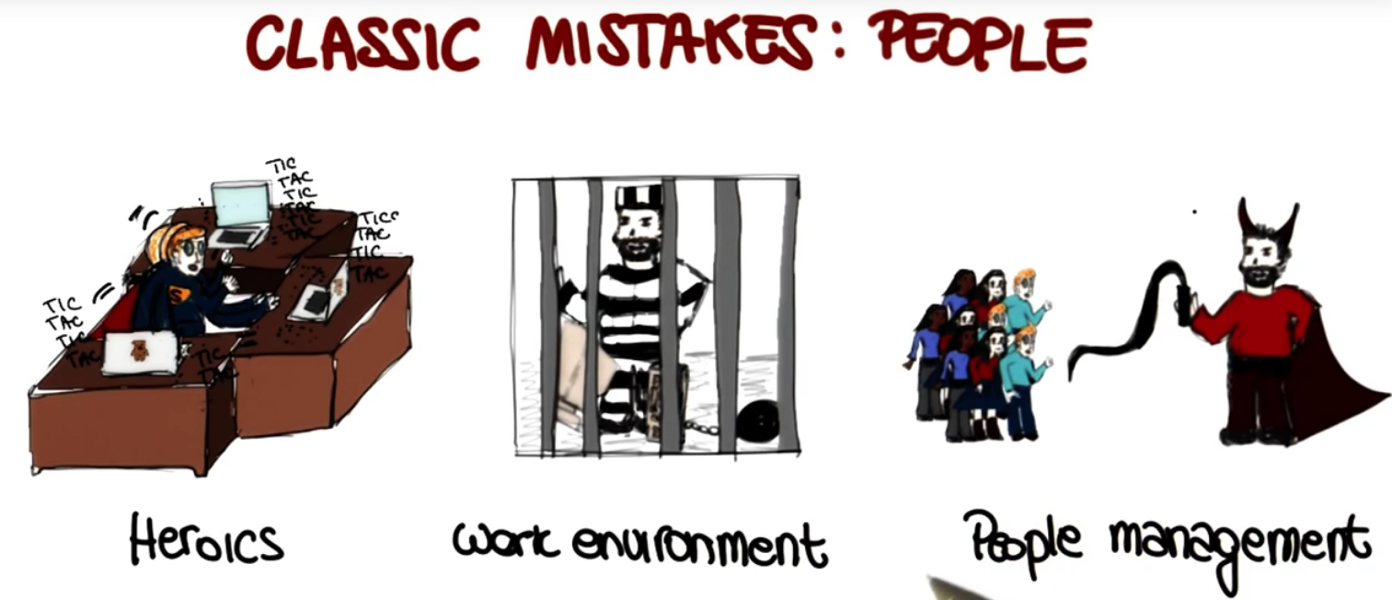

Slide 25
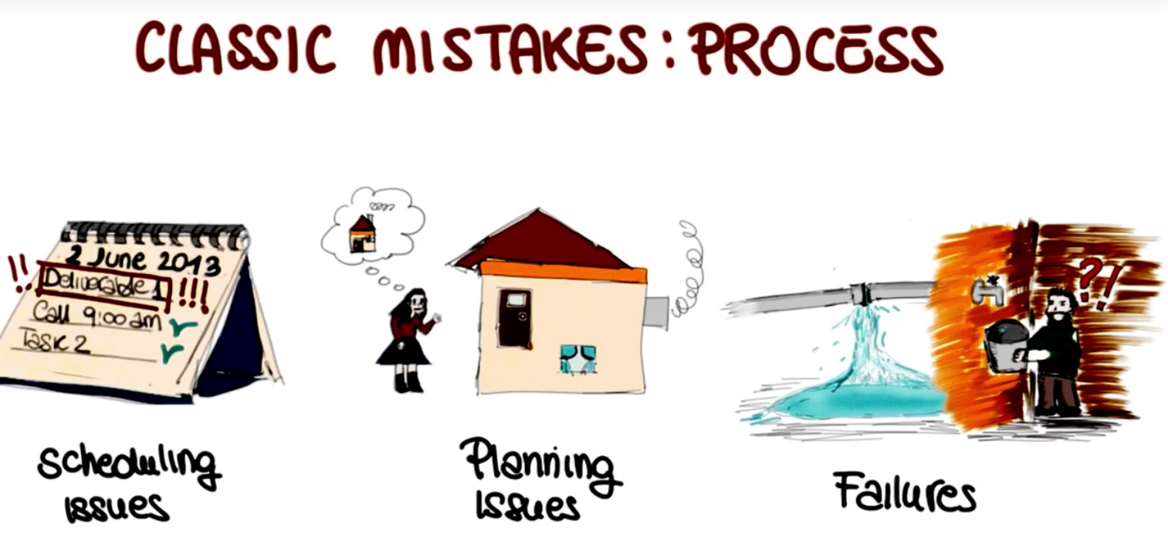

Slide 26
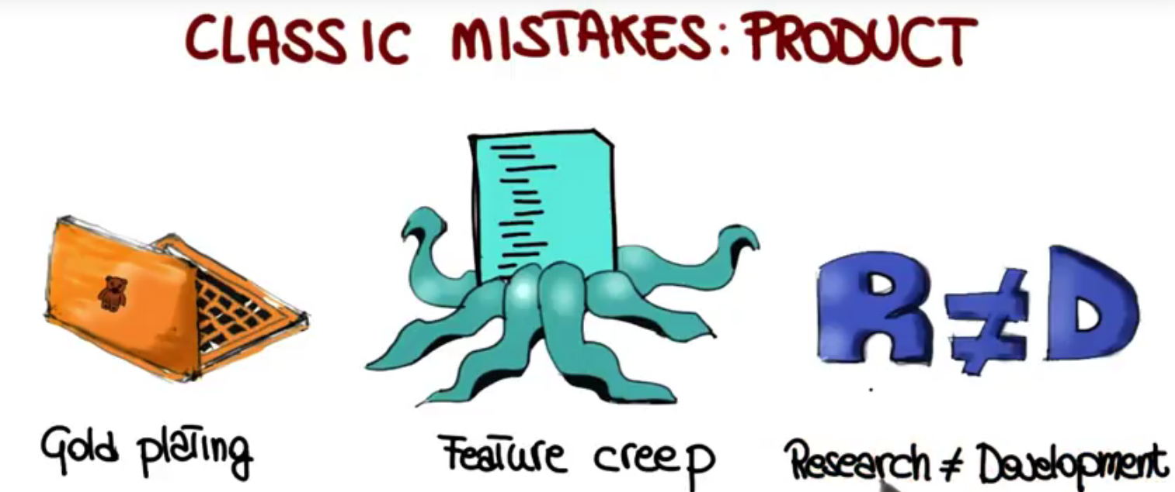

Slide 27
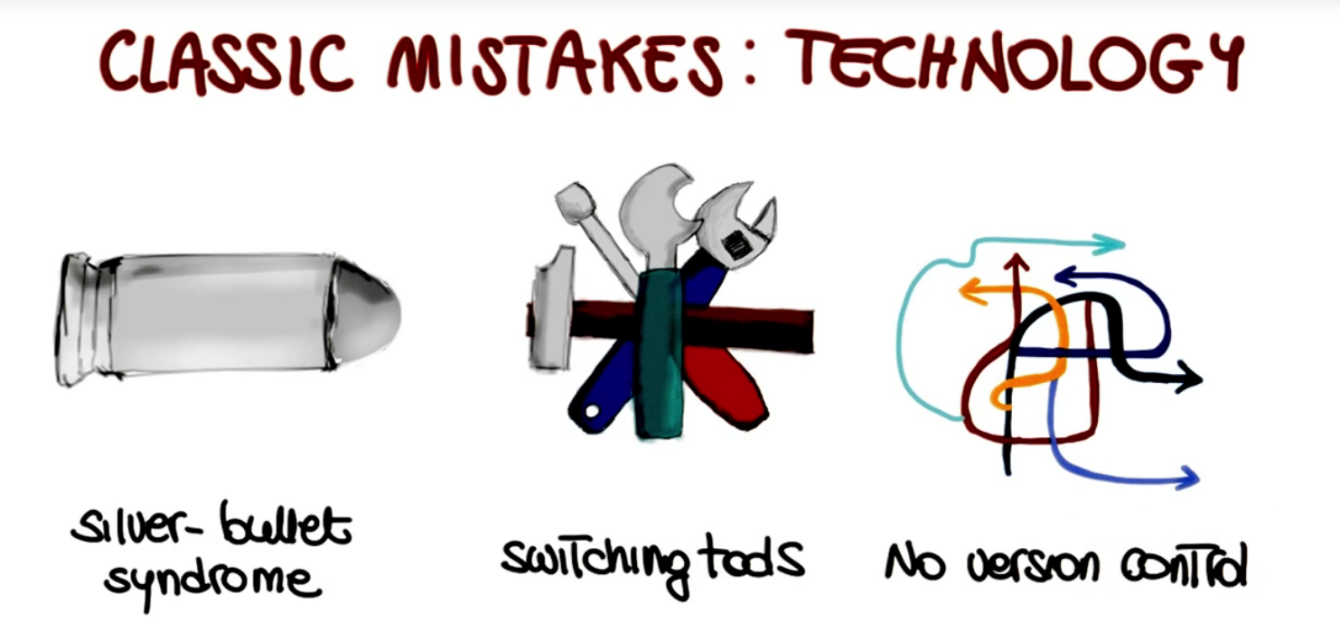

Slide 28
References
Sommerville I. Software Engineering (9 ed.), Addison Wesley, 2011, 790 pp.
Schach S.R. Object Oriented and Classical Software (8 ed.), McGraw-Hill, 2011, 688 pp.
McConnell S. Code Complete. Microsoft Press, 1993
Zykov S.V. Crisis Management for Software Development and Knowledge Transfer, Springer, 2016

